Slide 1
VIRTUAL REALITY
IN THERAPY
ROUND 3
Track: Social Welfare
Team name: Crewmates

Slide 2

RECAP
Phobias and anxiety disorders need to be addressed efficiently
Primitive means of exposure is not feasible as it is not controllable
Exposure therapy can be carried out in a safe and controlled way using virtual reality
Lets see the working flow of the VR exposure therapy

Slide 3



Start

Slide 4
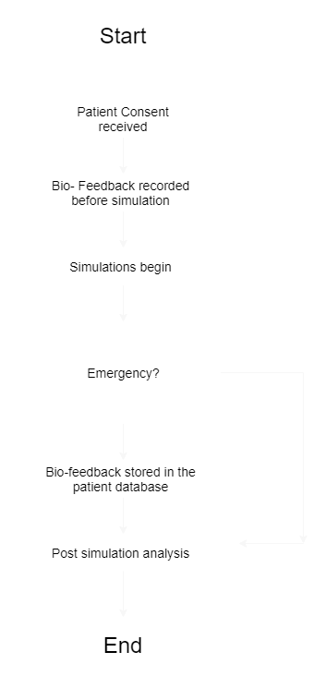
Workflow

Slide 5
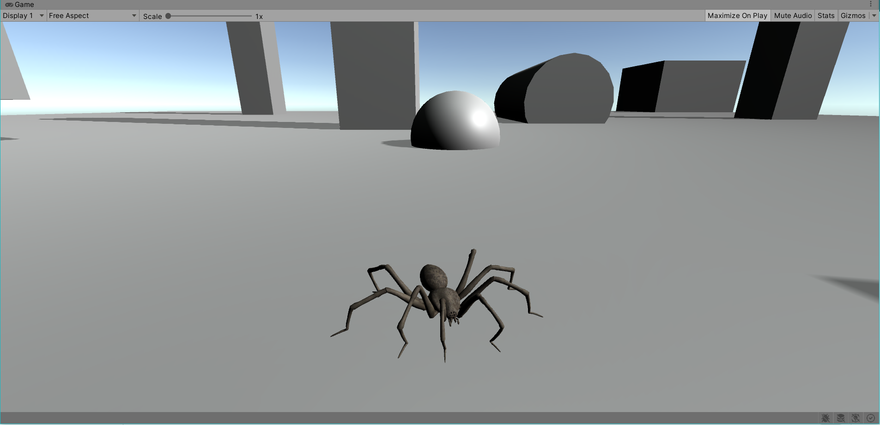
Simulation Begins
The patient is subjected to VR exposure therapy.

Slide 6
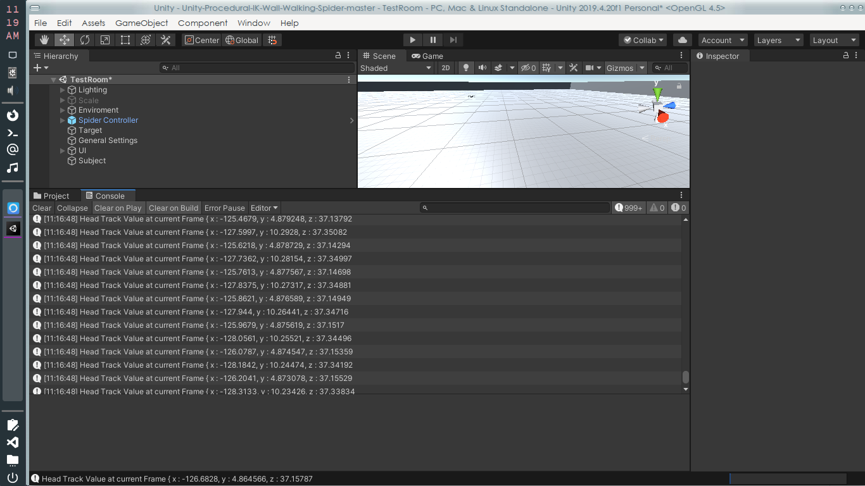
Workflow
x,y,z coordinates for each head movement is noted. The data is stored in a database which can then be accessed by the app for visualisation

Slide 7
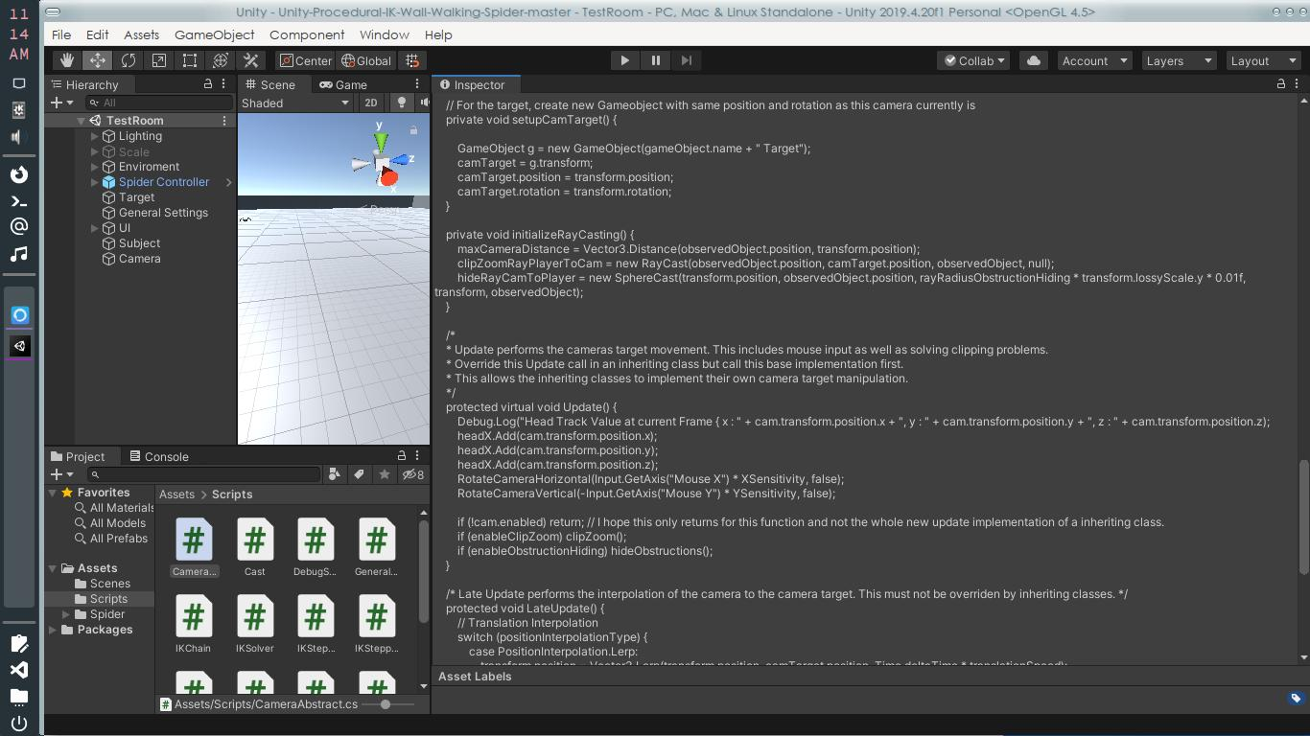

Slide 8
ALGORITHM
---------------------------- Combination Algorithm ---------------------------------------
Over the time frame, up until now we analysed one particular scale with respect to time frame across various session.
Combined algorithm has the potential of all the three graphs combined in an much more efficient and appropriate percentages.
The prevalence of the percentages is backed up by extensive research and is cited as follows
The results of a 2008 meta-analysis indicate that multiple sessions might be somewhat more effective than the single-session approach, as measured by questionnaire-based functional outcomes at follow-up,81 and careful consideration is needed when choosing the appropriate number and duration of sessions for patients;89 however, the massed single-session approach could be considered a viable option for suitable patients.
// Phobias
// William W Eaton, O Joseph Bienvenu, Beyon Miloyan
// Lancet Psychiatry. Author manuscript; available in PMC 2020 May 18.
// Published in final edited form as: Lancet Psychiatry. 2018 Aug; 5(8): 678–686. doi: 10.1016/S2215-0366(18)30169-X
// PMCID: PMC7233312
//Heatbeat Rate - 62 %
// Experiment conducted used an emotional attentional blink paradigm time locked to specific phases of the cardiac cycle and quantified the detection breakthrough of emotional stimuli (ie fear)
// Cardiac cycle was ascertained using electrocardiography (ECG)
// In the majority of trials (>80%) proved the correlation
// Fear from the Heart: Sensitivity to Fear Stimuli Depends on Individual Heartbeats
// J Neurosci. 2014 May 7; 34(19): 6573–6582.
// doi: 10.1523/JNEUROSCI.3507-13.2014
// PMCID: PMC4012313
// PMID: 24806682
// Sarah N. Garfinkel,corresponding author1,2 Ludovico Minati,1,3 Marcus A. Gray,4 Anil K. Seth,2,5 Raymond J. Dolan,6 and Hugo D. Critchley1,2

Slide 9
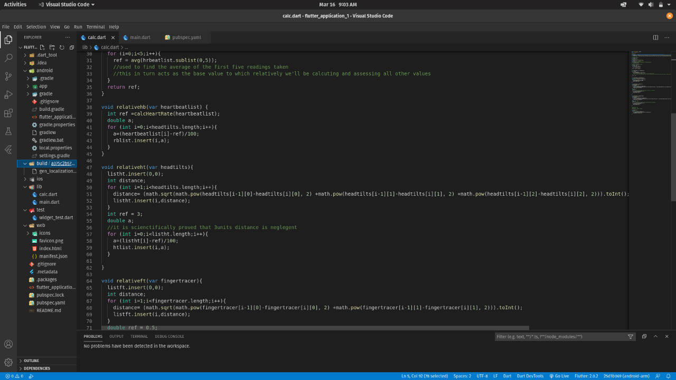
ANALYSIS

Slide 10
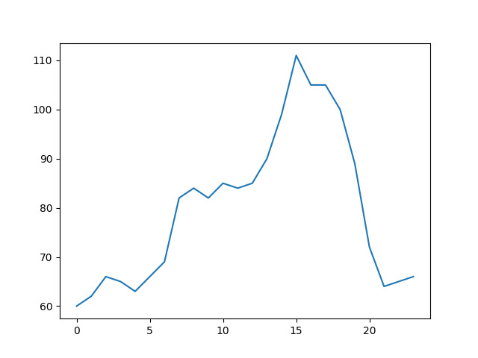
ANALYSIS IN PYTHON
//Head Movement Distance - 20 %
// Effectiveness is around (60<) during the experimentation although theoritically the correlation values seems way high.
// An appriach to VR based head and eye movement as to response to fear stilmuli correlation evailuvation system
// Dutko J, VArgic R
// 15 May 2018,
// Bratisava, Slovakia
// Finger Movement Distance - 18 %
// The use of imagery to elicit clinically pertinent distress is premised on the expectation that imagining frightening narratives activates brain circuitry implicated in animal models of human fear Error bars represent 95% confidence intervals
// Reflexes in Psychiatry
// Richard D. Sanders, MD and Paulette Marie Gillig, MD, PhDcorresponding author

Slide 11
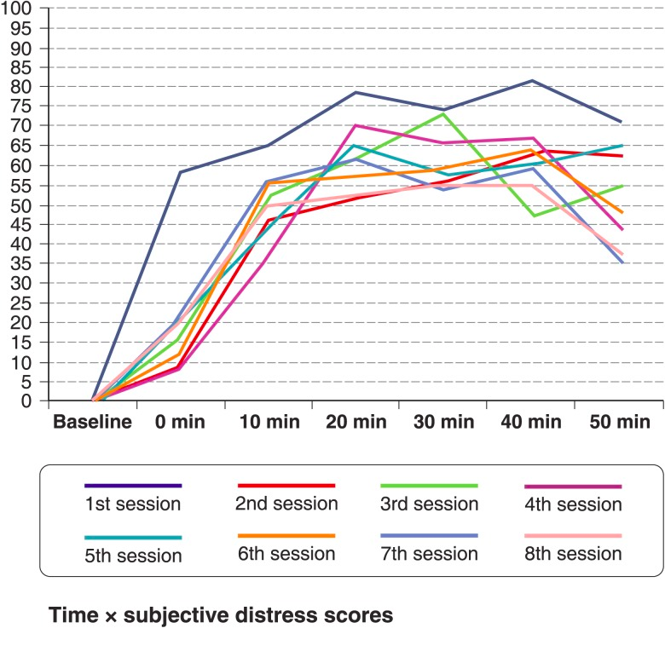
ANALYSIS IN PYTHON

Slide 12
CONCLUSION
THANK YOU!
Thus VRET is more feasible than primitive exposure therapy providing more benefits and features while being cost effective all the while. More modules and VR environments can be added in the future as seen fit and has a lot of scope for further expansion

